Slide 1
Realtime Crypto Prices with Apache Kafka
Will Schnirring, Nathan O’Connor,
Ashhad Syed

Slide 2

Objective
Connect real time data stream to existing framework
Kafka
Producer, consumer
Python web app displaying results

Slide 3
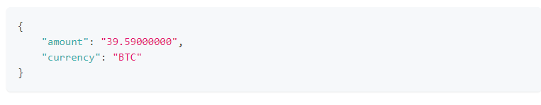
Data Source
Coinbase API
Provided by Coinbase, a company that operates a cryptocurrency exchange platform.
Rate limit: 10/sec

Slide 4
Kafka Server
Setting up Zookeeper (terminal 1)
bin/zookeeper-server-start.sh config/zookeeper.properties
Start Server (terminal 2)
bin/kafka-server-start.sh config/server.properties
Creating a topic
$ bin/kafka-topics.sh --create --topic quickstart-events --bootstrap-server localhost:9092

Slide 5
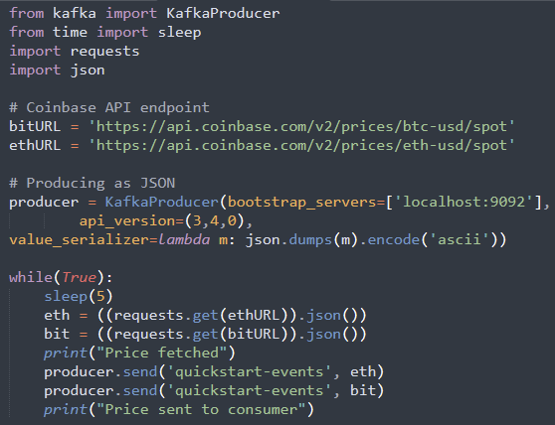
Producer
Call the API every 5 seconds
Get JSON of price + timestamp
Send to Kafka topic
python3 producer.py

Slide 6
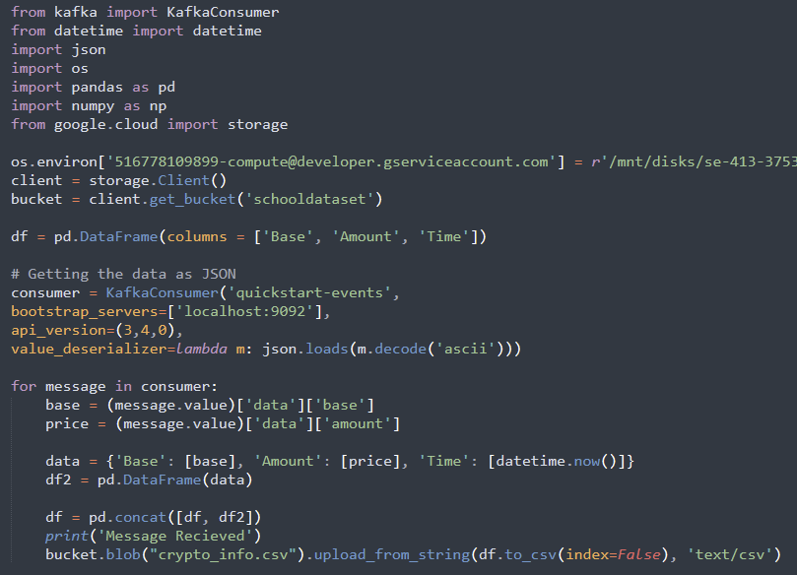
Consumer
Consumer.py script
Stores crypto data into a dataframe
Dataframe saved onto Mount storage bucket
For each message from producer,
Format and write to pandas dataframe
python3 consumer.py

Slide 7
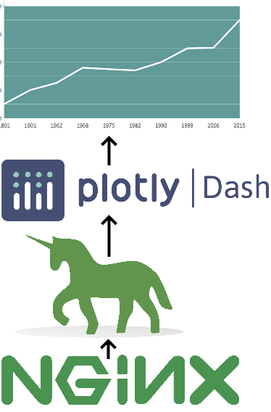
Graphing
Plotly Dash (Flask)
Gunicorn + NGINX
Gateway, proxy server
Graphs for different coins

Slide 8
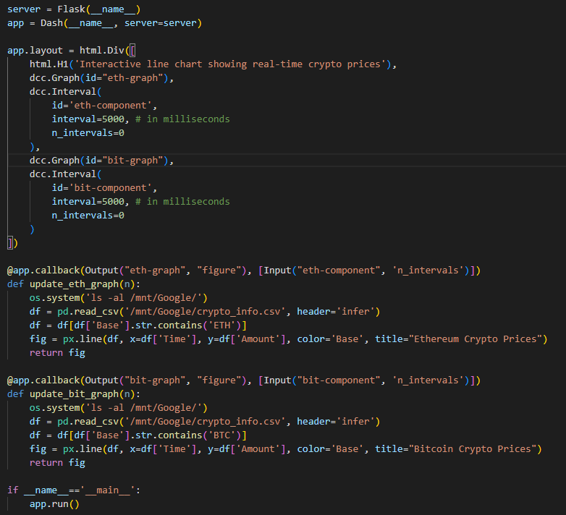
Real-time Graphing
realtime.py script
Reads csv from cloud storage bucket
Graphs each cryptocurrency on its own graph
Graphs are set to update every 5 seconds

Slide 9
Results

